Slide 1
Lecture 3

Slide 2
Question 123.1.11
A circular object is in uniform motion. The drawing is at t = 0. The projection on the x-axis shown will have what amplitude and phase?
0.50 m and 0
1.00m and 0
0.50m and π
1.00m and π
Can you draw a graph of x vs. t?
0.50m
x

Slide 3
Question 123.1.12
The circular object pictured here is made to rotate clockwise at 29 revolutions per second. It is filmed with a camera that takes 30 frames per second. Compared to its actual motion, the dot on the film appears to move
Clockwise at a very slow rate
Counterclockwise at a very slow rate
Clockwise at a very fast rate
Counterclockwise at a very fast rate
In a random fashion

Slide 4
Trigonometry
ĵ
Remember defining trig functions on a unit circle?
P
y
h
θ
x
î

Slide 5
Trigonometry
ĵ
Suppose we define points along the x-axis (and let the circle have radius h)
P
y
h
θ
-x_{max}
x
x_{max}
î

Slide 6
Dot product
ĵ
We could express the length x as the component of the radius vector or
P
y
r
θ
-x_{max}
x
x_{max}
î

Slide 7
Relationship to SHM
ĵ
The projection of the position of point P on the x axis displays SHM!
P
h
θ
-x_{max}
x
x_{max}
î
SHM along a straight line can be thought of as a projection of a uniform circular motion along a diameter of a reference circle

Slide 8
More Geometry
We can also define points along the y-axis
ĵ
y_{max}
P
y
h
θ
-x_{max}
x
x_{max}
î
-y_{max}

Slide 9
Relationship to SHM
ĵ
This is just two SHOs
One in the x direction
One is the y direction
y_{max}
P
y
h
θ
-x_{max}
x
x_{max}
î
-y_{max}

Slide 10
Equations for the two SHOs
The equation in X is familiar
The projection onto the y-axis is a sine function
An old trig identity says:
What does this say about the phases of the two SHOs?

Slide 11
Rotation and Velocity
Look at the Angular Speed
Then
Let’s take the x-component
ĵ
v_{t}
v_{tx}
θ
y
θ
v_{tx}
î

Slide 12
Rotation and Acceleration
The acceleration of the particle at P is given by
Taking the x- component
ĵ
a_{x}
θ
y
a
θ
a_{x}
î

Slide 13

$$x\left(t\right)={x\cos\left(ωt+φ_{o}\right)}_{max} \\ v\left(t\right)=−ω{x\sin\left(ωt+φ_{o}\right)}_{max} \\ a\left(t\right)=−ω^{2}{x\cos\left(ωt+φ_{o}\right)}_{max}$$
$$ω=2πf$$
$v_{m}=ωx_{m}$
$a_{m}=ω^{2}x_{m}$
$T=\frac{1}{f}$
$U_{s}=\frac{1}{2}kx_{max}^{2}$ $\cos^{2}\left(ωt+φ\right)$
$K=\frac{1}{2}mω^{2}x_{max}^{2}\sin^{2}\left(ωt+φ\right)$
$T=2π\sqrt{\frac{m}{k}}$
$$f=\frac{1}{2π}\sqrt{\frac{k}{m}}$$

Slide 14
θ
L
T
m
W_{t}
θ
W_{r}
W=mg

Slide 15
Pendulum
θ
T
L
The forces on M are F_{g}, the tension on the string
The tangential component of F_{g} is always directed toward
This is a restoring force! Take
Then the restoring force is
m
s
θ
mg
If we restrict ourselves to small angles
Which looks familiar

Slide 16


$$y=θ$$
$$y=\sin{θ}$$
θ

Slide 17
Pendulum
SHM Problem
θ
T
L
m
θ
W
Solution

Slide 18


Slide 19

Physical Pendulum
o
Pivot
Suppose we build a pendulum by making a large solid object swing from one point.
Restoring force
Remember that
θ
d
CM
Pivot
dsin(θ)
CM
W=mg
Then
Or
Another familiar differential EQ

Slide 20
Physical Pendulum
o
Pivot
SHM Problem
θ
d
CM
dsin(θ)
W=mg
Solution

Slide 21
Torsional Pendulum
A torsional pendulum is made by suspending a rigid body from a wire. The body rotates.
twisted wire exerts a restoring torque on the body that is proportional to the angular position (sound familiar)
Rotational version of Newton’s 2nd Law
P
Then
Physics majors and those taking PH 220 in the future, you will see a torsional pendulum again!

Slide 22
Motion of a Torsional Pendulum
P
P
θ=0
θ=θ_{max}
θ=0
θ = -θ_{max}

Slide 23
Torsional Pendulum
SHM Problem
P
Solution

Slide 24
Damped Oscillations

Slide 25
S_{ms}
D_{mf}
W_{mE}

Slide 26
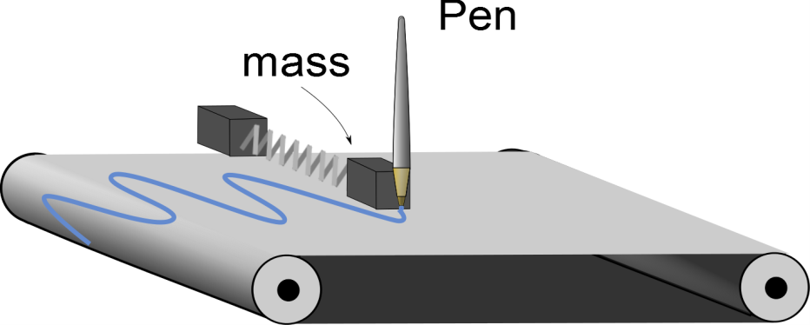
Question 6.14
I have placed a red pen in my SHM gizmo and started the chart moving. I get a strip chart that looks like the page shown to the right. What can you conclude about my oscillator system
The machine is broken
The oscillator experiences friction of some sort
The oscillator is losing mass

Slide 27
Add a frictional force
Suppose we add in a force that is proportional to the velocity
Viscosity follows this pattern
b is the damping coefficient
Newton’s 2nd law gives
This is another differential equation. It is harder to guess its solution

Slide 28

Solution
Where
Three Cases
1. The retarding force is small: (bv_{max}< kA), the system oscillates, but the amplitude is smaller as as time goes on. We call this "underdamped“
2. The retarding force is large: (bv_{max}> kA), The system does not oscillate. we call this "overdamped." We can also say that
(after we define ω_{N} below)
3. Case The system is critically damped (see below)
$$\frac{b}{2m}>ω_{N}$$

Slide 29
Example
The gray lines are the “envelope” function
They describe how the amplitude changes

Slide 30
Larger b-value

Slide 31
Even Larger b-value
Note Scale Change!
Oscillation has stopped,
Only the exponential decay is observed.
we are critically damped

Slide 32
Forced Oscillations

Slide 34
Leg movements at the same frequency as the swing’s natural frequency make the swing go higher

Slide 35
Driving Force
Last section we added a force that killed our oscillation
Suppose we want to keep it going
Add a force
where F_{o} is a constant and where ω_{f} is the angular frequency of the driving force
This one is very hard to solve

Slide 36
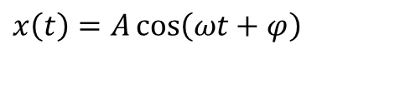



Steady State
Let’s assume that we add in enough energy with the driving force that we make up for the energy lost in the damping force
Then the solution is
EXCEPT
We will drop the subscript f for convenience
$$A=\frac{\frac{F_{max}}{m}}{\sqrt{{\left(ω_{f}^{2}−ω_{N}^{2}\right)}^{2}+{\left(\frac{bω_{f}}{m}\right)}^{2}}}$$
$$ω_{N}=\sqrt{\frac{k}{m}}$$
$$A=\frac{\frac{F_{max}}{m}}{\sqrt{{\left(ω^{2}−ω_{N}^{2}\right)}^{2}+{\left(\frac{bω}{m}\right)}^{2}}}$$
$$x\left(t\right)=A\cos\left(ωt+φ\right)$$

Slide 37
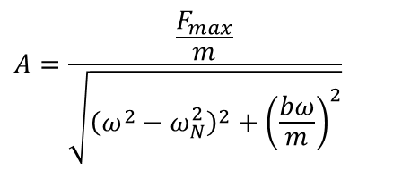

Example
Notice that right at ω_{o} our solution gets very big
$$A=\frac{\frac{F_{max}}{m}}{\sqrt{{\left(ω^{2}−ω_{N}^{2}\right)}^{2}+{\left(\frac{bω}{m}\right)}^{2}}}$$
$ω$ (rad/sec)

Slide 38

Resonance
To see why resonance happens, think of the velocity
And our driving force is
The rate at which work is done (power) is
if F and v are in phase, the power will be at a maximum!
$$F\left(t\right)=F_{max}\sin\left(ωt\right)$$

Slide 39

Example
Resistive force is never really zero in real systems
It can be small
Small b
Large b
$ω$ (rad/sec)

Slide 40
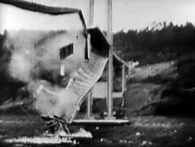
Remember Tacoma Narrows?
The wind gusts formed a periodic driving force that allowed a driving harmonic oscillation to form.
Since the bridge was resonant with the gust frequency, the amplitude grew until the bridge materials broke.

Slide 41

Remember Tacoma Narrows?
The wind gusts formed a periodic driving force that allowed a driving harmonic oscillation to form.
Since the bridge was resonant with the gust frequency, the amplitude grew until the bridge materials broke.

Slide 42





Summary
SHM along a straight line can be thought of as a projection of a uniform circular motion along a diameter of a reference circle
Pendulum
Physical Pendulum
Torsoinal Pendulum
Damped Oscillation
Forced Oscillation
$$ω=\sqrt{{ω_{N}}^{2}−{\left(\frac{b}{2m}\right)}^{2}}$$
$$ω_{N}=\sqrt{\frac{k}{m}}$$
$$b_{c}=2mω_{N}$$
$$A=\frac{\frac{F_{max}}{m}}{\sqrt{{\left(ω^{2}−ω_{N}^{2}\right)}^{2}+{\left(\frac{bω}{m}\right)}^{2}}}$$
$$F\left(t\right)=F_{max}\sin\left(ω_{f}t\right)$$

Slide 43




Critical Damping
$$\frac{b}{2m}=ω_{N}=\sqrt{\frac{k}{m}}$$
Condition for critical damping
Then
Where is the natural frequency of the system
We define
Remark When the solution in equation (damped solution) is not valid!
You will find out more about this situation in your advanced mechanics classes.
$$ω_{N}=\sqrt{\frac{k}{m}}$$
$$b_{c}=2mω_{N}$$
$$\frac{b}{2π}≥ω_{N}$$

Slide 44
END

